Slide 1

TREINTA UDes
Jonathan Felipe Ochoa silva
20212020039

Slide 2
Introduction
Project Objetive
Develop an application to manage inventory, tables, and sales in a restaurant.
Technologies Used
FastAPI
Uvicorn
Poetry
SQLAlchemy

Slide 3
Project Description
Inventory Management
Recording and controlling products
Updating stock levels
Table Management
Create new tables
Update table (add, remove or close)
Sales Management
Processing orders
Recording sales and payments

Slide 4
Project Architecture
Backend
FastAPI: Framework for building fast and efficient APIs.
SQLAlchemy: ORM for database management.
Server
Uvicorn: Fast ASGI server to run FastAPI applications.
Dependency Management
Poetry: Tool for dependency management and packaging.

Slide 5
FastAPI
Modern and fast framework for building APIs with Python.
Features
Automatic data validation
Automatic documentation with Swagger UI and ReDoc
High performance and ease of use

Slide 6
Uvicorn
ASGI (Asynchronous Server Gateway Interface) server for Python.
Advantages
High performance and low resource consumption
Support for HTTP/2 and WebSockets
Ideal for asynchronous applications like FastAPI

Slide 7
SQLAlchemy
ORM (Object-Relational Mapping) for Python.
Features
Mapping objects to database tables
Efficient and secure SQL queries
Support for multiple databases (SQLite, PostgreSQL, MySQL, etc.)

Slide 8
Database Schema (SQL_Lite)
Inventory
Products (ID, Name, Quantity, Price)
Tables
Tables (ID, name)
Sales
Sales_history (ID, total_value, time)
Product_sales(ID, Product_id, Product_quantity, sale_id)

Slide 9
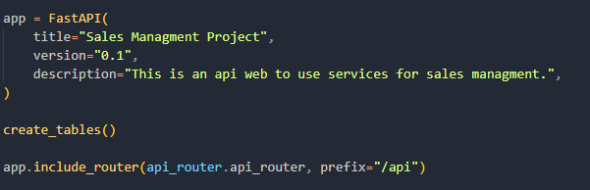
Implementation in FastAPI

Slide 10
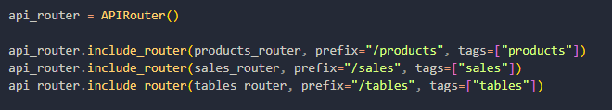
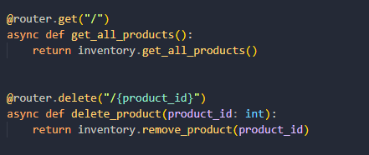

Slide 11
Conclusion
This project aimed to create an efficient and reliable system for managing inventory, tables, and sales in a restaurant setting.
By leveraging modern technologies like FastAPI , Uvicorn, Poetry, and SQLAlchemy, we were able to build a scalable and maintainable application.
Efficient management of inventory, tables, and sales is critical in the restaurant industry for maintaining customer satisfaction, reducing waste, and increasing profitability.
This project demonstrates the power of modern web technologies in solving real-world business problems, highlighting the importance of adopting cutting-edge tools and methodologies in software development.

